Slide 1

Annual Members vs. Casual Riders
Presented By: Kevin Larkin
Last Updated: October 13th, 2021

Slide 2
Table of Contents
Annual Members vs. Casual Riders
Objective
Ride Length
Summary
Appendix
Top 5 Routes
Bike Type
Rider Share
Recommendations
Ride Count

Slide 3

Objective

Slide 4
Objective
Identify how annual members and casual riders use Cyclistic bikes differently in order to create a marketing strategy to convert casual riders into annual members.

Slide 5

Rider Share

Slide 6
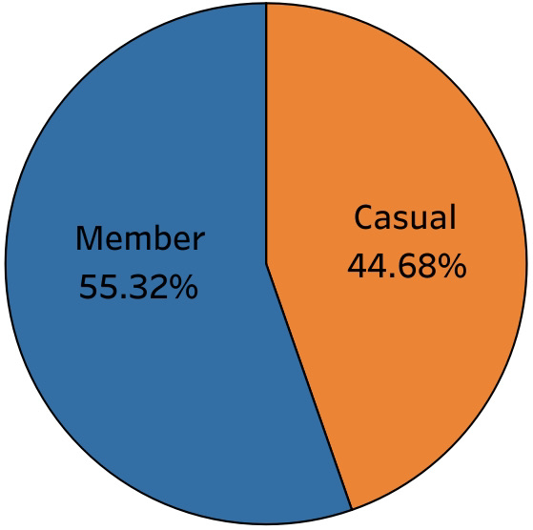
Rider Share Overall
Sep 2020 – Aug 2021
Just over 4,100,000 total trips.
Annual members made up most overall rides, but not by much.
Notes:
Explain dataset here before introducing visual

Slide 7
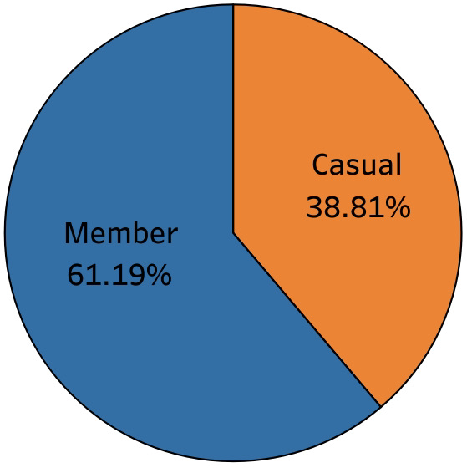
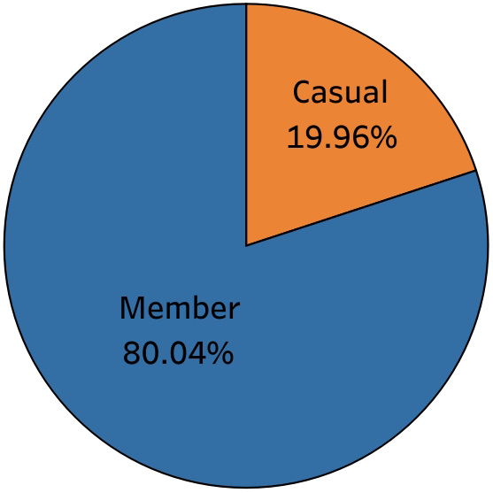
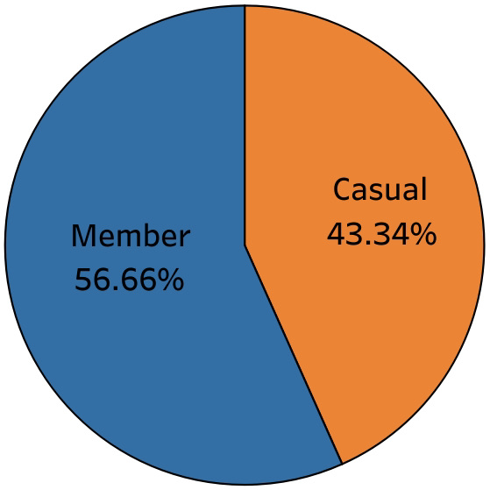
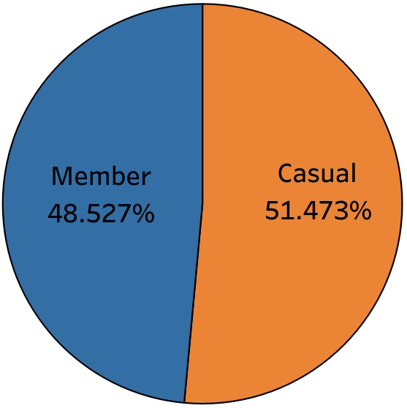
Rider Share By Season
Fall 2020
Winter 2020
Spring 2021
Summer 2021
In fall 2020, which had 25% of all rides, the majority were annual members.
In winter 2020, which had 6% of all rides, the large majority were annual members.
In spring 2021, which had 23% of all rides, the majority were annual members.
In summer 2021, which had 47% of all rides, the majority were casual members.
Annual members made up the majority for all seasons except summer.
Notes:
Add that classic bikes did not appear in the dataset until December 2020 but were still easily the most popular

Slide 8

Bike Type

Slide 9
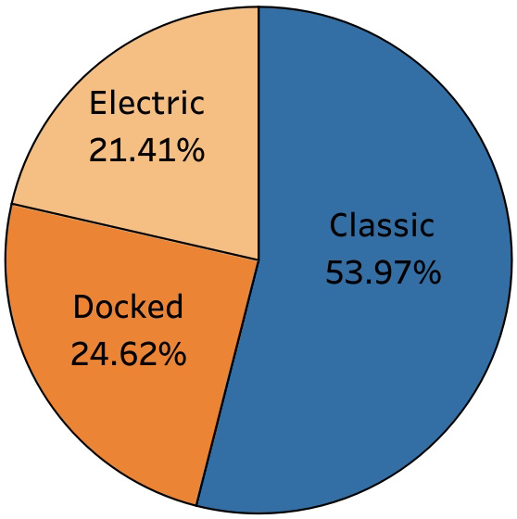
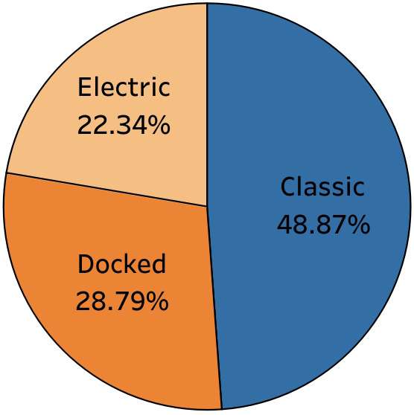
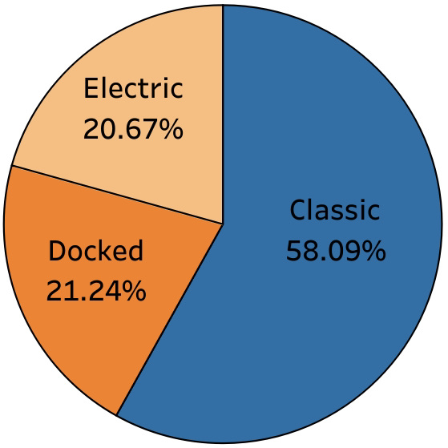
Bike Type Overall
Sep 2020 – Aug 2021
Sep 2020 – Aug 2021 Casual
Sep 2020 – Aug 2021 Members
Classic bikes did not appear until December 2020.
Docked bikes stopped appearing after February only for members.
Classic bikes are by far the most popular and electric bikes are the least popular.
Slightly more docked and electric for casual riders.
Largely more classic bike usage for annual members.
Notes:
Add that classic bikes did not appear in the dataset until December 2020 but were still easily the most popular

Slide 10
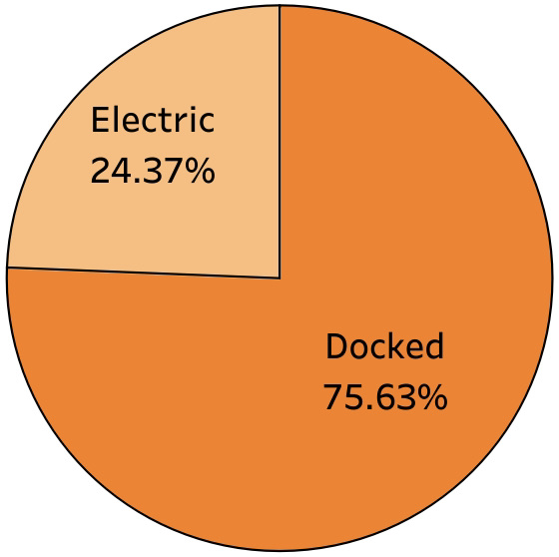
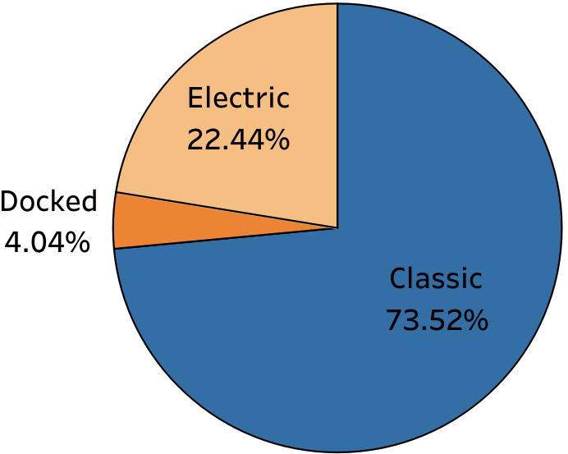
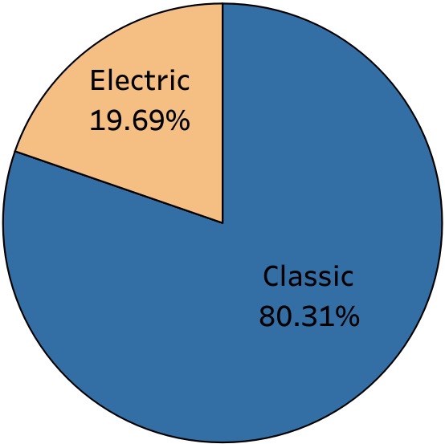
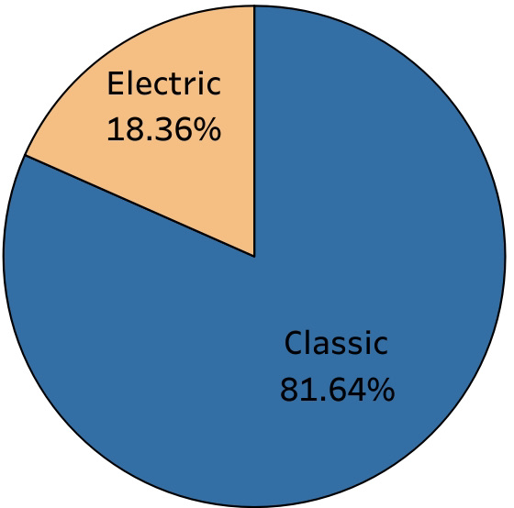
Bike Type By Season- Member
Fall 2020
Winter 2020
Spring 2021
Summer 2021
Fall 2020 had large majority docked bikes, with electric next and no classic.
Winter 2020 had large majority classic bikes, with electric next and no docked.
Spring 2021 had large majority classic bikes, with electric next and no docked.
Summer 2021 had most classic bike usage, with electric next and no docked.
Classic bikes made up the majority for most seasons.
Seems like docked bikes were replaced by classic bikes.
Notes:
Add that classic bikes did not appear in the dataset until December 2020 but were still easily the most popular

Slide 11
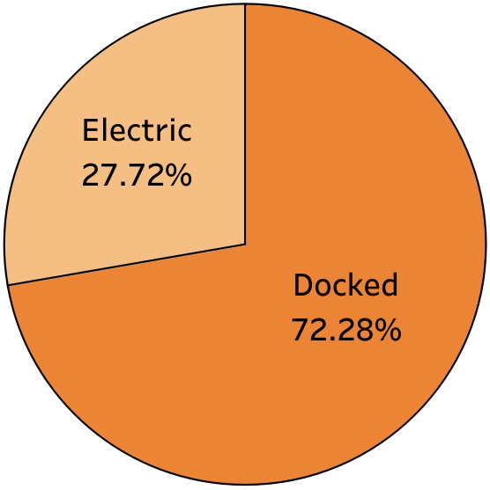
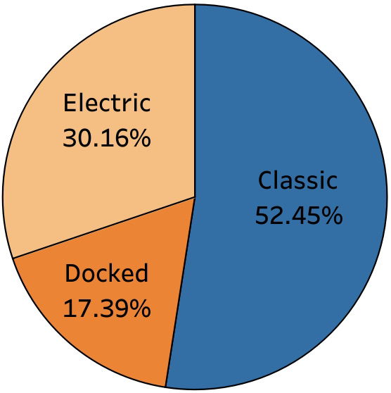
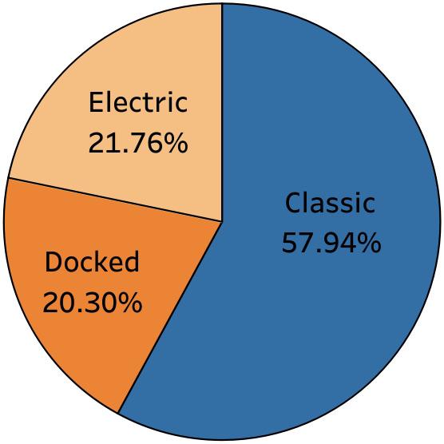
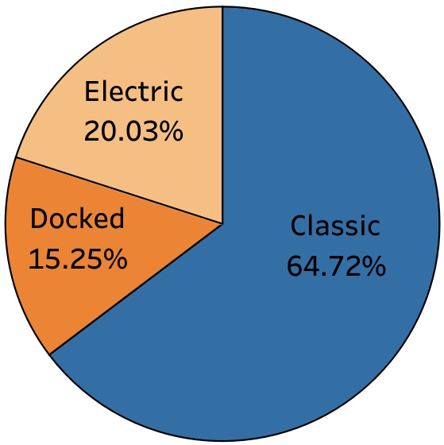
Bike Type By Season- Casual
Fall 2020
Winter 2020
Spring 2021
Summer 2021
Fall 2020 had large majority docked bikes, with electric next and no classic.
Winter 2020 had large majority classic bikes, with electric next and docked last.
Spring 2021 had large majority classic bikes, with docked next and electric last.
Summer 2021 had most classic bike usage, with electric next and docked last.
Classic bikes made up the majority for most seasons.
Docked bikes present in all four seasons but diminish in popularity.
Notes:
Add that classic bikes did not appear in the dataset until December 2020 but were still easily the most popular

Slide 12

Ride Count

Slide 13
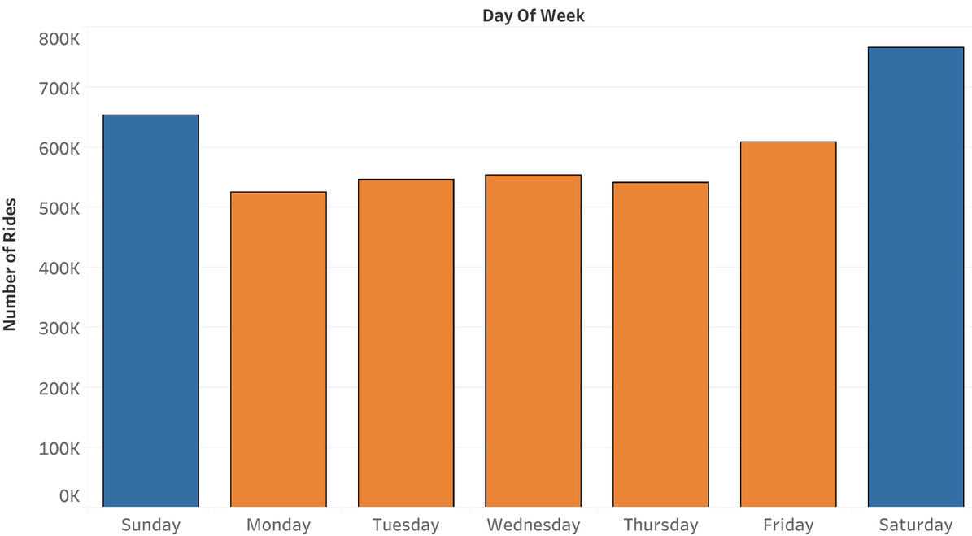
Ride Count Per Day Overall
Sep 2020 – Aug 2021
Weekends are the most popular days for rides.
Saturday is the most popular and Monday is the least.
Notes:
Explain dataset here before introducing visual

Slide 14
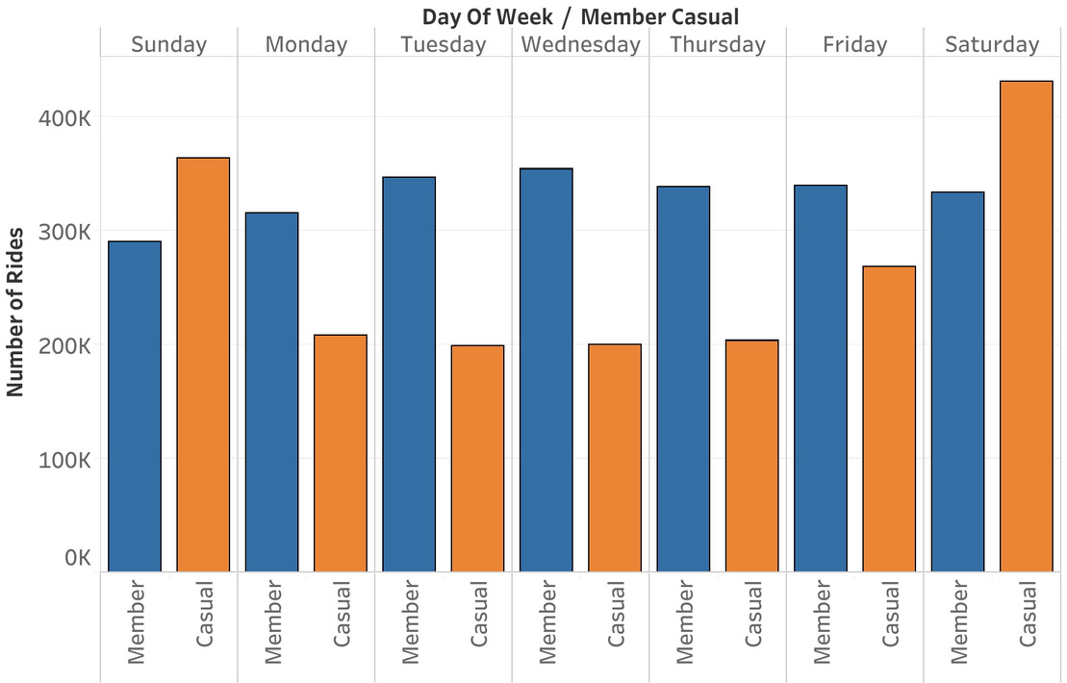
Ride Count Per Day By Rider Type
Sep 2020 – Aug 2021
Weekdays are more popular for members and weekends are more popular for casual riders.
Wednesday is the most popular day for members and Saturday is the most popular day for casual riders.
Notes:
Explain dataset here before introducing visual

Slide 15

Ride Length

Slide 16
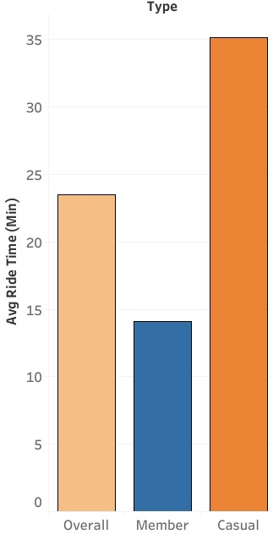
Ride Length Overall
Sep 2020 – Aug 2021
Overall average was 23:30
Annual members’ average was 14:06
Casual riders’ average was 35:09
Spring had longest average at 25:06 and winter had lowest at 16:23.
Notes:
Explain dataset here before introducing visual

Slide 17
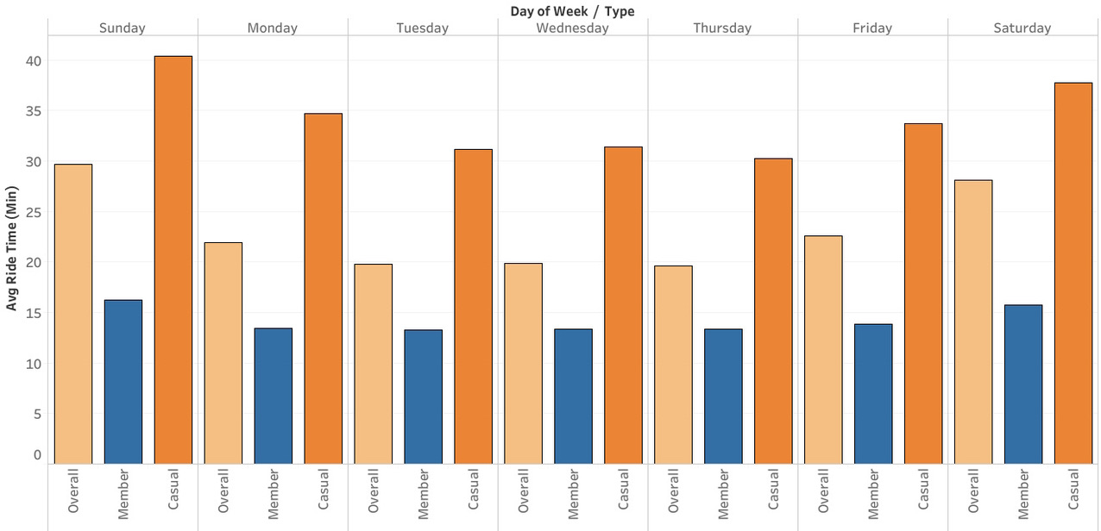
Ride Length By Day of Week
Sep 2020 – Aug 2021
Longest rides on average were on weekends and shortest on weekdays.
Sunday was the longest and Thursday was the shortest for all three.
Members most likely ride the same routes for commuting while casual riders ride for weekend leisure.
Notes:
Explain dataset here before introducing visual

Slide 18

Top 5 Routes

Slide 19
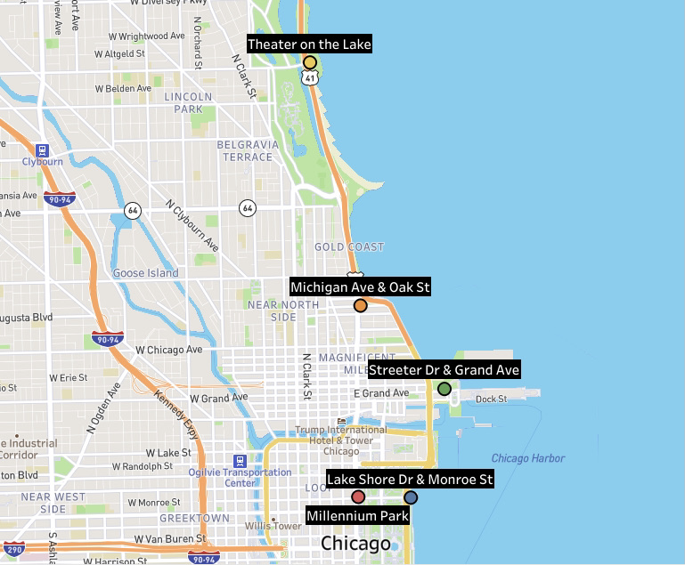
Top 5 Routes Overall
Sep 2020 – Aug 2021
All round trips
Streeter Dr & Grand Ave
Lake Shore Dr & Monroe St
Millennium Park
Michigan Ave & Oak St
Theater on the Lake
Notes:
Explain dataset here before introducing visual

Slide 20
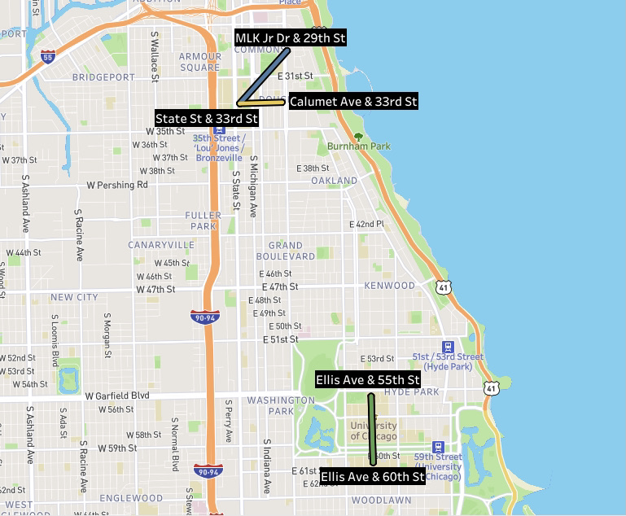
Top 5 Routes For Members
Sep 2020 – Aug 2021
All one-way trips
Ellis Ave & 60th St – Ellis Ave & 55th St
Ellis Ave & 55th St – Ellis Ave & 60th St
MLK Jr Dr & 29th St – State St & 33rd St
State St & 33rd St – MLK Jr Dr & 29th
State St & 33rd St – Calumet Ave & 33rd St
Notes:
Explain dataset here before introducing visual

Slide 21
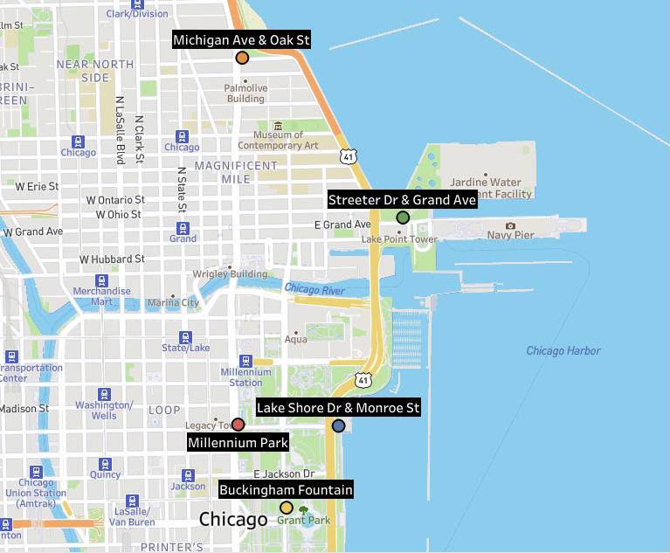
Top 5 Routes for Casual Riders
Sep 2020 – Aug 2021
All round trips
Streeter Dr & Grand Ave
Lake Shore Dr & Monroe St
Millennium Park
Michigan Ave & Oak St
Buckingham Fountain
Notes:
Explain dataset here before introducing visual

Slide 22

Summary

Slide 23
Summary
Annual Members
Make up majority of all trips
Make up majority of all seasons except for summer
Prefer classic bikes
Ride slightly more on weekdays than weekends
Ride on average 14 minutes consistently throughout the week
Make trips with different starting and ending stations
Casual Riders
Make up slightly less of all trips
Make up majority of summer but the minority of all other seasons
Prefer classic bikes but not quite as much
Ride much more on weekends than weekdays
Ride on average 35 minutes with the longest on weekends and shortest on weekdays
Make round trips

Slide 24
The Average Rider
Annual Members
Most likely use Cyclistic bikes for work commutes.
Their trips are around the same length every day, use bikes more on weekdays, and ride the same routes to and from consistently.
Casual Riders
Most likely use Cyclistic bikes for joy rides or exercise.
Ride way more frequently in the warmer seasons, ride more on weekends and for longer, and make round trips.

Slide 25

Recommendations

Slide 26
Top 3 Recommendations
Increase advertising efforts in warmer seasons and at stations casual riders use most often, such as Streeter Dr & Grand Ave, Lake Shore Dr & Monroe St, and Millennium Park.
01
Target casual riders that use bikes in similar ways to members, such as casual riders who ride on weekdays.
02
Provide rewards incentives for becoming a member the more you ride, since casual riders ride for much longer durations.
03

Slide 27

Thank you! Questions?

Slide 28
Appendix
Case Study Rubric: Follow this link
Changelog: Cyclistic Case Study Changelog
Datasets Used: Follow this link (202009-divvy-tripdata.zip – 202108-divvy-tripdata.zip)

